Slide 1


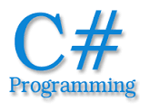

Introduction To Programming
What is Computer Programming?
SoftUni Team
Technical Trainers
Software University
http://softuni.bg

Slide 2

Table of Contents
Computer Programming
Computer Program
Basic Structure
Algorithms
C# as a language
Microsoft Visual Studio as an IDE
How to create a simple program
“Hello, World!”

Slide 3
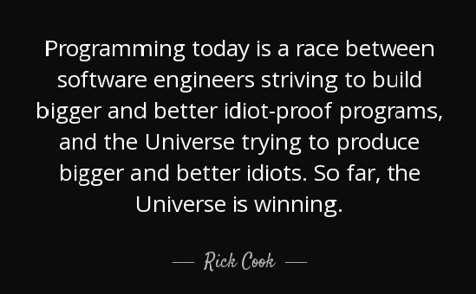
What is Computer Programming?

Slide 4

The Process Called - Computer Programming
Computer Programming is the process of developing and implementing various sets of instructions to enable a computer to do a certain task
These instructions are considered to be Computer Programs

Slide 5
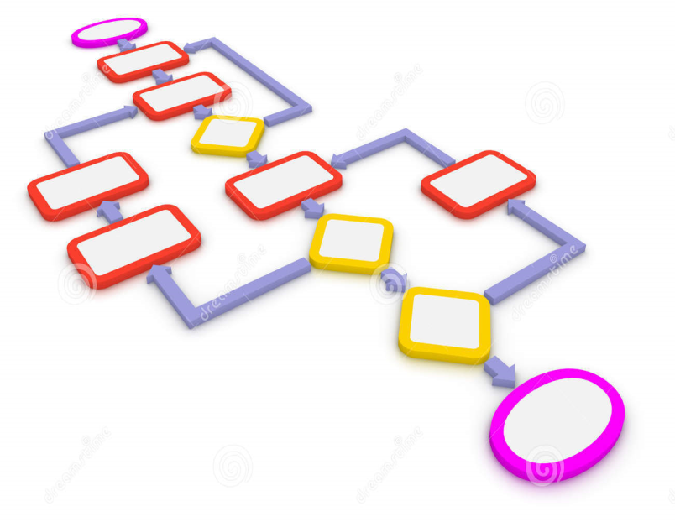
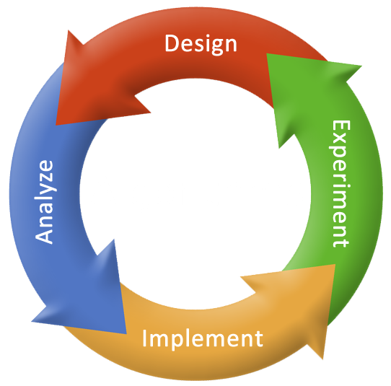
Algorithms
An algorithm is a set of ordered and finite steps to solve a given problem.
An algorithm is developed in several steps:
Problem definition and development of algorithm model
Specification and designing of algorithm
Analysis of algorithm and its correctness
Implementation of algorithm
Program testing

Slide 6
Algorithms
Let us see a graphical representation of a simple example algorithm.
False
START
INPUT X
INPUT Y
X > Y
OUTPUT Y
True
OUTPUT X
STOP

Slide 7
Algorithms
For more complex conditions it is better to use decision tables.
Client | Case 1 | Case 2 | Case 3 | Case 4
Has Membership? | Yes | Yes | Yes | No
Has Special Holiday Discount? | Yes | Yes | No | No
Has V.I.P. Status? | Yes | No | No | No
Product Discount | 85% | 35% | 15% | 0%

Slide 8



What is C#?

Slide 9

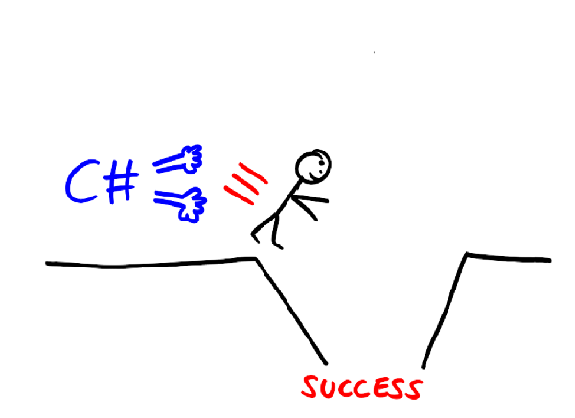
C# as a Language
C# is a programming language that is designed for building a variety of applications that run on the .NET Framework
Multi-paradigm
Simple, modern and general-purpose
Strongly-typed
Object-oriented

Slide 10

Visual Studio as an IDE
Microsoft Visual Studio is an integrated development environment (IDE) from Microsoft.
It is used to develop:
computer programs
web sites
web applications and web services.

Slide 11

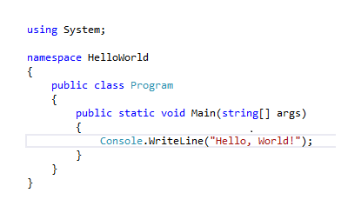
Live Demo

Slide 12
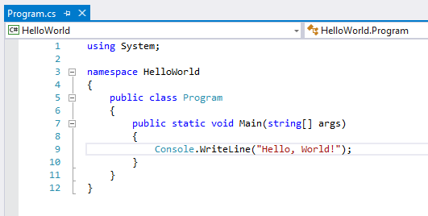
Demo Explanation
Using directive
Namespace
Class
Method
Code Statement

Slide 13

Summary
What does Computer programming mean?
What is a Computer program?
What is an Algorithm?
What is C#?
What is Visual Studio?
How to make a simple “Hello, World!” program.

Slide 14








Title
https://softuni.bg/courses/javascript-applications/

